Slide 1

Elementary and Secondary School Emergency Relief (ESSER) Roundtable Series: 5
Learning Acceleration
New Jersey Department of Education
Division of Educational Services
February 16, 2022

Slide 2

Using Microsoft Teams
  Chat
    We welcome your participation in discussions by asking questions and adding comments in the chat box.
  Raise Hand
  Please use the raise hand feature if you want to speak.
  Mute/Unmute
    Please remain muted whenever you are not speaking.
Notes:
Peggy

Slide 3
Agenda
Housekeeping Dr. A .Charles Wright, Executive Director/Deputy Assistant Commissioner Division of Educational Services
Welcome Ms. Kathy Ehling, Assistant Commissioner, Division of Educational Services
Learning Acceleration Ms. Lisa Haberl, Acting Director, Office of Standards, Division of Teaching and Learning Services
District Presentations
Newton Public School District
Dr. G. Kennedy Greene, Superintendent
Beverly City Public School District
Dr. Elizabeth C. Giacobbe, Superintendent
Ms. Kerri A. Lawler, Director of Curriculum & Instruction
Metuchen Public School District
Dr. Vincent Caputo, Superintendent
Rick Cohen, Assistant Superintendent

Slide 4
Welcome

Slide 5
Leveraging the
New Jersey Department of Education’s
Learning Acceleration Guide

Slide 6
Agenda
Learning acceleration definition​
Learning acceleration principles​
Examples in New Jersey schools and districts​

Slide 7
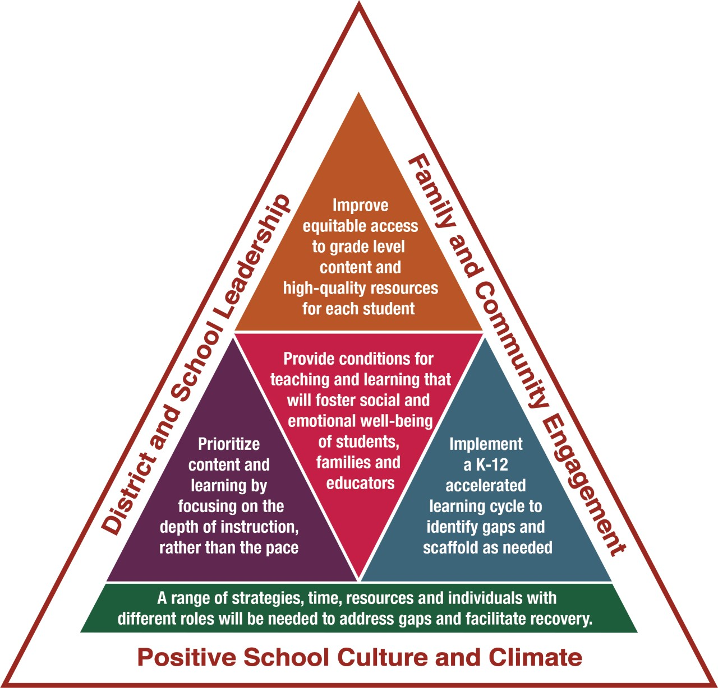
What is Learning Acceleration?
Learning acceleration is an ongoing instructional process by which educators engage in formative practices to improve students’ access to and mastery of grade-level standards.

Slide 8
Four Principles of Learning Acceleration
Provide conditions for teaching and learning that will foster social and emotional well-being of students, families and educators.
Improve equitable access to grade level content and
high-quality resources for each student​.
Prioritize content and learning by focusing on the depth of instruction, rather than the pace. ​
Implement a K-12 Accelerated Learning Cycle to identify gaps and scaffold as needed.

Slide 9
Conditions of Learning
Provide conditions for teaching and learning that will foster social and emotional well-being of students, families and educators.
Create a system that meets students’ social, emotional, and academic needs.
Establish safe, positive, and stable environments.
Teach critical social, emotional, and academic skills using an integrated approach.
Provide access to support from school counselors, psychologists, and trusted staff members.

Slide 10
Conditions of Learning: Strategies
Create a Community Response Team that includes members of municipal government, law enforcement, clergy, youth groups and other civic leaders.
Partner with the local food pantry to create an onsite food market in school buildings.
Build a school wellness team from members of the learning ecosystem; create a wellness room (a safe space where students can go when stressed or if they have been bullied).
Use trained therapy dogs in wellness programs.

Slide 11
Equitable Access
Improve equitable access to grade level content and high-quality resources for each student.
Focus on grade-level content and rigor.
Create access and opportunity to a well-rounded education.
Implement culturally responsive practices.
Recognize how students' diverse experiences and backgrounds add value to classroom learning environment.
Emphasize applied learning and diverse ways of thinking and problem solving.
Provide early access to content rather than remediation.

Slide 12
Equitable Access: Strategies
Create staffing positions to support and enact comprehensive equity plans, ensuring institutional structures exist to support the plan.
Offering summer bridge programming to support more students in accessing AP/IB/CTE coursework; offer new advanced courses aligned to student interest.
Form committees of district staff and parent liaisons to help select new instructional materials and other resources that reflect the community.

Slide 13
Depth of Instruction
Prioritize content and learning by focusing on the depth of instruction, rather than the pace. ​
Review curriculum to ensure alignment with NJSLS.
Adapt curriculum to focus on instructional priorities.
Allow for "just-in-time" instruction.
Design authentic learning experiences that activate student interest and prior knowledge to increase depth of understanding.
Address multiple standards across content areas by using an interdisciplinary approach.

Slide 14
Depth of Instruction: Strategies
Review and update curricular units, purchase new and manipulatives and consumable materials for more student-centered experiences.
Identify common math and ELA learning gaps and develop afterschool programming to include engaging content as a platform (robotics, performing arts, health and wellness, careers).
Develop a summer or afterschool enrichment program with external community partners who can increase engagement through their lens and resources.

Slide 15
Learning Acceleration Cycle
Implement a K-12 Accelerated Learning Cycle to identify gaps and scaffold as needed.
Determine grade-level learning objectives based on priority content.
Elicit, collect and analyze data including formative practices.
Address the identified needs through customized supports for accelerated learning.
Continually monitor student learning progression towards learning objective.

Slide 16
Learning Acceleration Cycle: Strategies
Plan professional development around formative practices and provide time and space for collaborative discussions.
Train and/or hire coaches to help analyze assessments for evidence of learning gaps and plan interventions and scaffolds for support.
Purchasing and using a comprehensive data management system that aggregates data from various sources to help tailor instruction to individual student needs quickly.

Slide 17
Thank You! (1 of 3)
New Jersey Department of Education: nj.gov/education
standards@doe.nj.gov
Follow Us!
Facebook:
@njdeptofed
Twitter: @NewJerseyDOE
Instagram:
@NewJerseyDoe

Slide 18
District Presentations

Slide 19
Newton Public Schools

Slide 20
Demographics
Newton is a town of over 8,000 people in the governmental seat of Sussex County -- we’re a regional hub for business, education, health care, and the arts.
We are a pK-12 district of 1,500+ students housed in four schools. Newton High School receives students from neighboring Andover Regional & Green Township.
Our student enrollment has grown steadily since 2010 after declining during the preceding decade.
We have a diverse student body that is 48% economically disadvantaged, 38% racial minority, 21% learning disabled, and 7% English language learner.

Slide 21
Highlights
High performing district with highest graduation and college enrollment rates ever.
Acknowledged by College Board Honor Roll for significant gains in AP access and student performance.
Affirmed as having the county’s healthiest elementary and middle schools, the most productive high school community service organization, a state model school for positive behavior interventions, and a national school of character.
State-recognized community schools model to provide health and social services directly to students and families.
Free full-day preschool, pK-2 aftercare, and grades 3-8 21st CCLC programs.

Slide 22
CARES (ESSER 1)
Total Allocation = $185,658
Major expenditures prioritized immediate instructional needs and health & safety:
OT, PT, BCBA contracted services ($106,000)
Digital devices such as wifi hotspots, chromebooks, laptops ($30,000)
Mental health services and supports ($20,000)
Sanitizing supplies ($29,658)

Slide 23
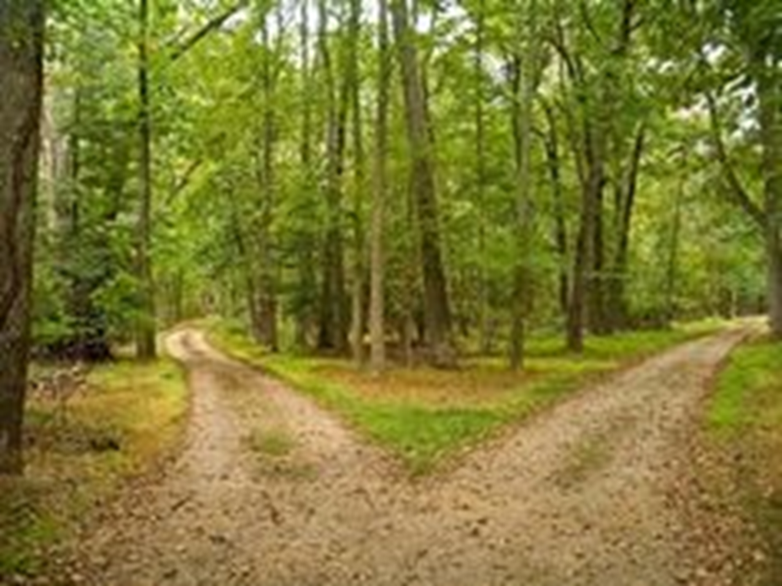
A Road Less Traveled
tinyurl.com/4r9fu3m4
Our call to action in Spring 2021
to reaffirm the mission of
the Newton Public Schools,
by synthesizing successful practices with pandemic experiences and
professional learning,
into district goals that
exhibit an equity-centered, context-sensitive approach.

Slide 24
A Road Less Traveled (cont.)
A Road Less Traveled
ESSER 2 Allocations
Maintain Student and Staff Health as an Essential Priority
Exhibit Behavior Before Belief and Communicate Clearly
Adopt Belonging and Dignity as Keys to Equity Implementation
Reimagine Schooling Through Equity
and Innovation
Move 21st Century Skills to the Heart of Curriculum, Instruction, and Assessment
Accelerate Learning Using Power Standards and Instructional Supports
Physical Health and Safety - health-trained assistants, indoor air quality assessment
Mental Health - intervention services, professional development, family support
School Culture and Climate - professional development on dignity and belonging
Digital Technology - digital learning lab
Summer Learning Academy - open to all K-12 students
Learning Acceleration - intervention services, professional development

Slide 25
CRRSA (ESSER 2)
Base = $721,450 Learning Acceleration = $46,299 Mental Health = $45,000
Summer Learning Academy - open to all K-12 students ($365,971)
Learning Acceleration - intervention services, professional development ($210,465)
Mental Health - intervention services, professional development, family support ($90,000)
Physical Health and Safety - health-trained assistants for screening, supervision, isolation ($65,434); indoor air quality assessment ($10,000)
Digital Technology - digital learning lab ($55,085)
School Culture and Climate - professional development on dignity and belonging ($15,794)

Slide 26
ESSER 2 Planning
Account | Total Planned | EOY | Local | ESSER 2 | MH | LA | MAS Title I | HMS Title I
100-100 | $379,029 | $29,589 | $67,326 | $172,434 |  | $24,489 | $14,795 | $14,794
100-200 | $15,064 |  |  | $13,191 |  | $1,873
100-600 | $44,639 |  |  | $21,750
200-100 | $70,149 | $9,796 | $7,802 | $52,551
200-200 | $10,262 |  |  | $4,020 |  |  | $3,121 | $3,121
200-300 | $7,020 |  |  | $7,020
Goal
Initiative
Expand extended school year
opportunities through a Summer
Learning Academy
3B

Slide 27

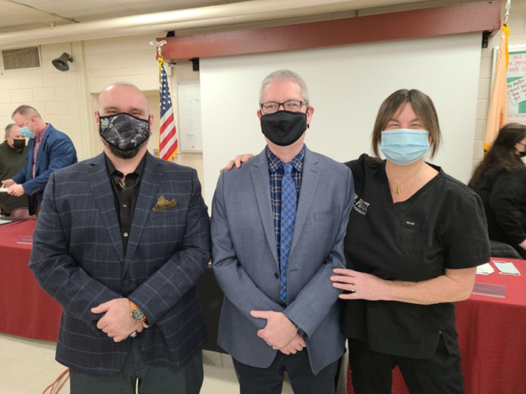

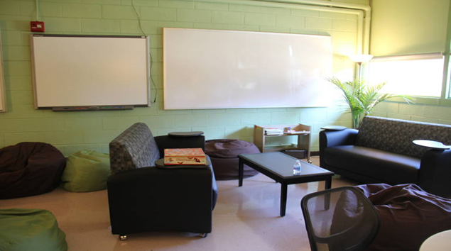
ESSER 2 Outcomes (1 of 3)

Slide 28
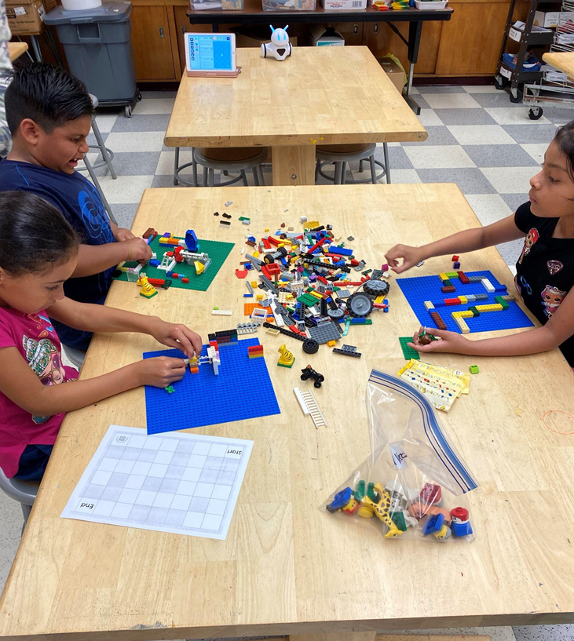
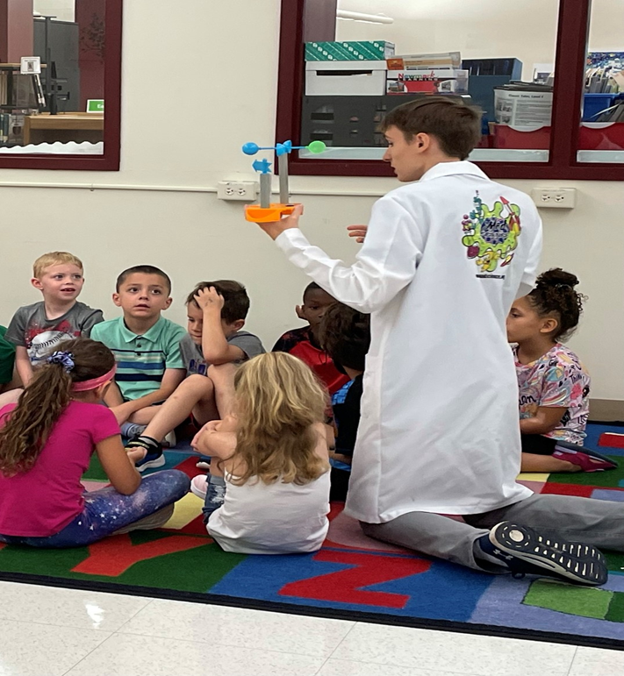
ESSER 2 Outcomes (2 of 3)

Slide 29
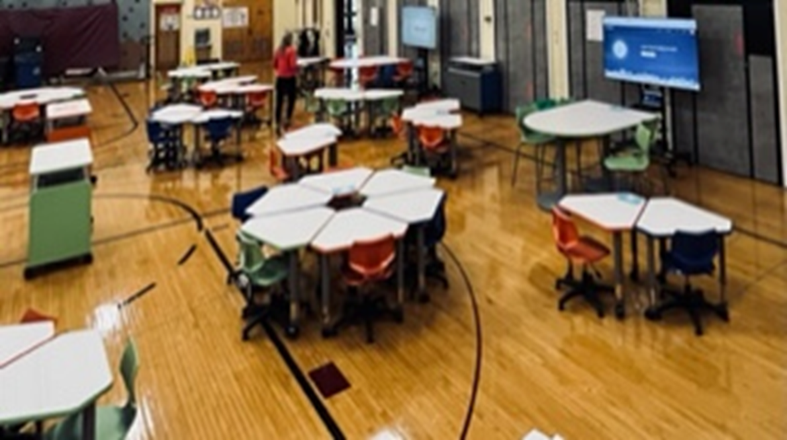

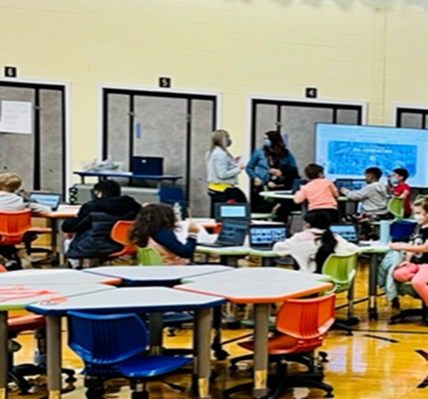
ESSER 2 Outcomes (3 of 3)

Slide 30
ARP (ESSER 3) Stakeholder Engagement
Oct 4-8 Student sessions (Week of Respect)
Oct 11-15 Staff sessions
Oct 20 Parent and Community session
All groups were encouraged to email
additional input to the Superintendent

Slide 31
District Goals and Key Strategies
Goal 1: ASSESSING AND ADDRESSING HEALTH NEEDS
Physical Health and Safety
Mental Health Assessments and Resources
Social Emotional Learning
Community Schools
Goal 2: BUILDING A CULTURE OF
DIGNITY AND A CLIMATE OF
BELONGING
Inclusive Classroom
Practices, Behavioral
Expectations, and
Disciplinary Practices
Meaningful Student
Involvement
Staff Recruitment and
Retention
Policy Review
Goal 3: STRENGTHENING
STUDENT-CENTERED
LEARNING
Formative Assessment
Accelerated Learning
Blended Instruction
Flexible Resource Allocation

Slide 32
SMALL GROUP DISCUSSION QUESTIONS
What strategies under each goal are most important in helping our students be successful in school?
What is the district doing now to address these needs that should be expanded?
What new ideas would address the needs?

Slide 33
What strategies are most important in helping our students be successful in school?
Goal 1: ASSESSING AND ADDRESSING HEALTH NEEDS
Physical Health and Safety
Mental Health
Assessments and
Resources
Social Emotional Learning
Community Schools
Goal 2: BUILDING A CULTURE OF
DIGNITY AND A CLIMATE OF
BELONGING
Inclusive Classroom
Practices, Behavioral
Expectations, and
Disciplinary Practices
Meaningful Student
Involvement
Staff Recruitment and
Retention
Policy Review
Goal 3: STRENGTHENING STUDENT-CENTERED LEARNING
Formative Assessment
Accelerated Learning
Blended Instruction
Flexible Resource Allocation

Slide 34
What is the district doing now to address these needs that should be expanded?
Students - MAS ¹ HMS ² NHS ³
Staff - MAS ⁴ HMS ⁵ NHS ⁶
Parents & Community ⁷
Assessing and Addressing Health Needs
Ventilation and air purifiers ³⁶
Building a Culture of Dignity and a Climate of Belonging
Staff helping students feel less marginalized (e.g. counselors, teachers)²³⁵⁶⁷
Strengthening Student Centered Learning
Increase wifi, infrastructure, connectivity ¹²³⁵⁷
Updated chromebooks ²⁴⁵
Academic supports (e.g. Tier 3 intervention time during and after school) ¹⁴⁵

Slide 35
What new ideas would address the needs?
Students - MAS ¹ HMS ² NHS ³
Staff - MAS ⁴ HMS ⁵ NHS ⁶
Parents & Community ⁷
Strengthening Student Centered Learning
Use audio-visual aids (e.g., teacher mics, replace smartboards) ²³⁵⁶
Expand summer enrichment (e.g. Ag, Robotics, freshmen, advertising) ⁴⁶⁷
Time for one-on-one check-ins with teachers (in-person or virtually) ²³
Others
Expand tech courses (e.g. typing, VR, coding, software development) ¹²³⁵
Incentivize TAs and subs for retention (e.g., salaries, tiered pay,
permanent subs) ⁴⁶
Support band/music (e.g., new uniforms, instruments) ²³⁶

Slide 36
ESSER 3 Planning
Description of Need | Data Sources Used to Determine the Need | District Goal(s) | NJDOE Evidence-Based Intervention(s) | Years | Funding Source | TOTAL | ESSER 3 20% to LA
Additional resources are needed for teachers to provide academic intervention and summer academy programs. | Stakeholder engagement input, K-8 formative assessment scores; K-12 course grades | Student Centered Learning | Learning Acceleration Guide, Multi-Tiered Systems of Support | 2022-23 2023-24 | ESSER 3 | $80,000 | $80,000

Slide 37
ARP (ESSER 3)
Initiatives
Tier 2/3 LA intervention services $382,808
Tier 2/3 MH intervention services $362,000
Indoor air quality improvement $300,000
Summer learning academy $276,414
Health trained assistants $142,098
Teacher leaders for LA $114,873
Academic intervention resources $80,000
Digital devices and connectivity $77,268
Covid testing supplies $72,000
Covid contact tracers $53,825
Allocations
Base = $1,861,286
LA = $114,873
MH = $45,000
ESY = $40,000
ESD = $40,000

Slide 38
Beverly City School District

Slide 39

A Culture of Accountability
Beverly City School District
​A National Title I Distinguished School
A NJDOE Lighthouse District
Dr. Elizabeth C. Giacobbe, Superintendent
Ms. Kerri A. Lawler, Director of Curriculum & Instruction
February 16, 2022

Slide 40
Beverly City School District: An Overview
Small, urban city located on the Delaware River
across from Philly
1 Pre-K through 8th grade school
Approximately 350 students
70% of students fall at or below the poverty level
100% of students receive free and reduced lunch
35 teachers and 3 FT administrators
Superintendent also serves as principal

Slide 41
Where We Were? Ground Zero
29.11%
Proficient
Math
32.3%
Proficient
ELA

Slide 42
What Ground Zero Looked Like:
Ground Zero – January 4th, 2011
  School security
  Corrective Action Plans (Title I - Wii, Fingerprints, 179 days, Signature stamp)
  BA quitting during budget season
  ALL students in self-contained classes
  Out of district tuition costs
  Failing School District – NJDOE classified Focus Status
  Very few working computers
  Textbooks copyrighted 1986
  No lesson plans/ no observations
  Students ran the building - anarchy

Slide 43
Culture of Accountability: (1 of 3)
  Developed C & I position/Grants Manager
    Re-wrote all grants
  Departmentalized middle school with highly
  qualified teachers
  Rewrote all curriculum
  Implemented baseline/benchmark assessments
  Taught teachers how to analyze data
  Implemented longer class periods
  Tenure case through arbitration
  Title II funds for on-going, embedded coaching

Slide 44
Culture of Accountability: (2 of 3)
  Teacher Academies: focusing on what is
  essential based on data
  What gets measured, gets managed -
  edConnect
    Technology: tools to teach and learn
  Online lesson planning with critical feedback
  People, not programs
    Utilized tenets of Achieve NJ to benefit our
    scholars
    Not okay to be bad at your job
    Danielson Model – Rarely give out 4s
    Corrective Action Plans (CAPs)
    Buy in from the Union – Everyone wants to be a
    part of a winning team

Slide 45
Culture of Accountability: (3 of 3)
  Streamlined School Day/Scheduling
    Extended our school hours
    Block of ELA in Middle School/Three (3) periods
    in K – 4
    Double math school-wide
  Professional Development Plan/Student Growth Objectives (SGOs)/Merit Goals
    1.5 years worth of growth in 8 months’ time
    Continuing CAPs
    “Fierce Conversations” (Scott, 2002)
    Every teacher is a reading/math teacher

Slide 46
March 2020 – COVID-19:
March 13 - school is closed for the foreseeable future
Meet with families to distribute materials
Administrative team distributes food weekly
Becomes obvious we need to have school in person in the fall
One of the only schools in the state open full-time, five days a week in September 2020

Slide 47
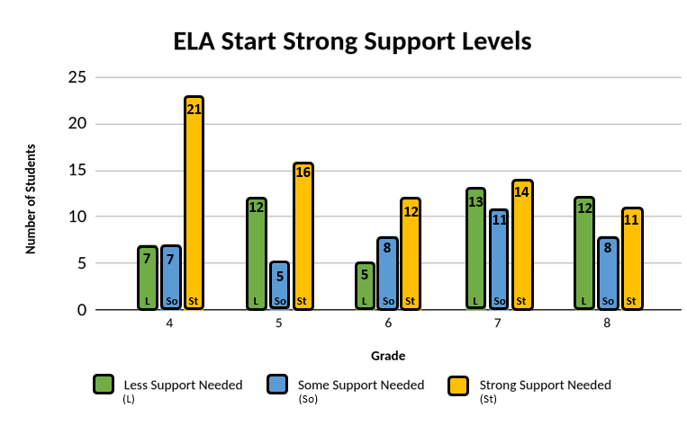
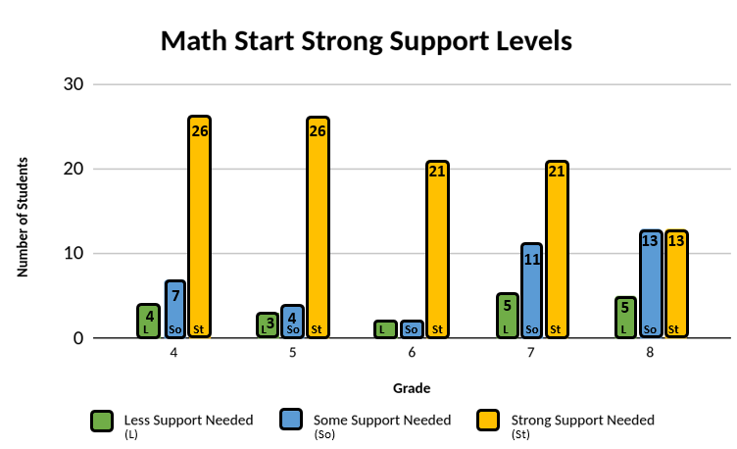
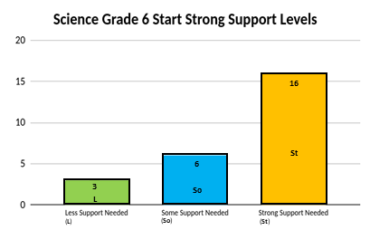
Where We Are Today:
Other Measures | 2019-2020 Proficiency | 2021-2022 Proficiency | Average Decrease
STAR Math | 58% on grade level | 46% on grade level | 12% percentage points
STAR Reading | 45% on grade level | 30% on grade level | 15% percentage points
Reading Running Record | 81% on grade level | 48% on grade level | 33% percentage points

Slide 48
Needs Assessment:
Data shows the following:
Students do not have the appropriate
space to learn and follow social distancing
Academic disparities in early learning, ELA, math, and STEM, as students are below in pre-reading and reading skills (similar to where we were in 2011)
Discipline referrals increased and student capacity for compassion and empathy decreased

Slide 49
ARP ESSER:
Beverly City School District is using the funding
to address the following issues:
20% learning loss instructors focusing on
unique needs of low-income students,
administering baselines and benchmarks to
attend to specific areas
School facility repairs including modular
classrooms and play areas because
enrollment data suggests CDC/DOH capacity guidelines are exceeded
Upgrading purification and control systems
to safely reduce virus transmission

Slide 50
Accelerated Learning Coach and Educator Support:
Beverly City School District is using the funding to do the following:
Hire instructional coaches
With teachers, use data from baselines/benchmarks to focus on the gaps to build a K-8 accelerated learning guide
Work with teachers weekly to model, observe, and improve teaching and learning
Continually improve comprehensive frameworks to anchor the district’s academic deficits in math, STEM, and ELA

Slide 51
Evidence Based Summer Learning and Enrichment:
Beverly City School District is using the funding to
do the following:
Host evidence-based summer learning and
enrichment in the following areas:
  Early Education
  STEM
  Music
  Reading, writing, social studies, social emotional
  learning
With teachers, use data from
baselines/benchmarks to focus on the gaps to
build programs to meet the needs of identified
students
Carefully sequencing skills to meet students’
needs and transitioning them back to school in
the fall more socially adept and academically
prepared

Slide 52
Evidence Based Comprehensive Beyond the School Day:
Beverly City School District is using the funding to do the following:
Hire a reading/writing interventionist familiar with struggling readers/writers/ELL student needs
Use data from baselines/benchmarks to focus on the gaps in writing, reading, communication
Work with students beyond their traditional class schedule

Slide 53
NJTSS Mental Health Support Staffing:
Beverly City School District does not have a counselor. These funds will address the following:
Rise in discipline referrals that stem from
difficulty adjusting to in-person instruction
I&RS referrals that are based on students’ behavioral, health, and/or attendance needs
The district will address these by doing the
following:
Analyzing data on student social emotional
needs
Contract with a mental health interventionist
Implement crisis counseling, group counseling, social skills groups, and individual counseling based on students’ needs

Slide 54
Questions?
Contact Information:
Beverly City School District
601 Bentley Avenue
Beverly, New Jersey 08010
www.beverlycityschool.org
609-387-2200
Dr. Elizabeth C. Giacobbe, Superintendent/Principal
egiacobbe@beverlycityschool.org
Ms. Kerri A. Lawler, Director of C & I and Grants Manager
klawler@beverlycityschool.org

Slide 55
Metuchen Public School District

Slide 56
ARP ESSER
Roundtable Series:
Metuchen’s applied use of ARP ESSER funds
Presented by:
Superintendent Dr. Vincent Caputo
Assistant Superintendent Rick Cohen

Slide 57
Vision and Guiding Principles in developing the use of funds
No staffing that would have to be cut when grant period ends
Aligned to student needs
Aligned to district goals
Start right away

Slide 58

ASCD’s The Whole Child

Slide 59
Metuchen Public Schools
2021-2022 District Goals Overview
Healthy
SEL Competencies
Safe
Inclusion and Equity
Engaged
Reading and Writing Across the Curriculum
Supported
Mental Health and School Climate
Challenged
STEM and UN Sustainable Development Goals
Sustainability
Referendum and Best Practices

Slide 60
ARP ESSER III
Function | Category | Amount | Focus | Need | District Goal
100-100 | Salaries | $114,000 | Quarantine & Sub-group Tutoring | Most Impacted by COVID | Supported Engaged
100-500 | Other Purchased Services | $440,000 | Tuition for 22 year olds | Additional year of service | Engaged
100-600 | Instructional Supplies | $35,000 | Phonics Materials | Foundational Skills | Engaged
200-100 | Salaries | $55,040 | Nursing Assistance | Health care | Healthy
200-200 | Benefits | $12,932
200-300 | Prof. and Tech Services | $100,000 | Additional BCBA support | Increased mental health | Safe

Slide 61
Accelerated Learning
Function | Category | Amount | Focus | Need | District Goal
200-100 | Salaries | $70,066 | Turn-key Trainings: Embedding Coping Skills Parent Academies | Training all staff on Mental Health Tier I and Tier II | Healthy Supported Sustainable
200-200 | Benefits | $5,360
200-300 | Prof. and Tech Services | $100,000 | Embedding Coping Skills National Writing Project Writing Revolution OG FDU Certification (2 yrs) OG 30 Hour training | SEL/Mental Health Road Forward Data Indicated Need for : Writing Foundational Skills | Healthy Engaged

Slide 62
Evidenced-Based Summer
Function | Category | Amount | Focus | Need | District Goal
100-100 | Salaries | $37,157 | Reading Intervention Tutors Learning Strategies / Executive Function programs | Foundational Skills Organizational and Emotional Regulation Skill Development | Engaged Supported
200-200 | Benefits | $2,843

Slide 63
Evidence-Based Beyond School
Function | Category | Amount | Focus | Need | District Goal
100-100 | Salaries | $37,157 | Reading Intervention Tutors Learning Strategies / Executive Function programs | Foundational Skills Organizational and Emotional Regulation Skill Development | Engaged Supported
200-200 | Benefits | $2,843

Slide 64
Mental Health Support Staff
Function | Category | Amount | Focus | Need | District Goal
200-300 | Prof. and Tech Services | $45,000 | Providing more BCBA support for Mental Health Tier I and II for Moss (PK-K) and Campbell Elementary (1-4) | Increased mental health | Safe

Slide 65
Thank you!
(2 of 3)
Please feel free to reach out with any questions any time:
Dr. Vincent Caputo
vcaputo@metboe.k12.nj.us
Rick Cohen
rcohen@metboe.k12.nj.us

Slide 66
Thank You! (3 of 3)
New Jersey Department of Education Website
nj.gov/education
Questions may be submitted to:
ESSER@doe.nj.gov
Registration now open for the March 16, 2022, ARP ESSER Round Table
Follow Us!
Facebook:
@njdeptofed
Twitter: @NewJerseyDOE
Instagram:
@NewJerseyDoe

